Slide 1
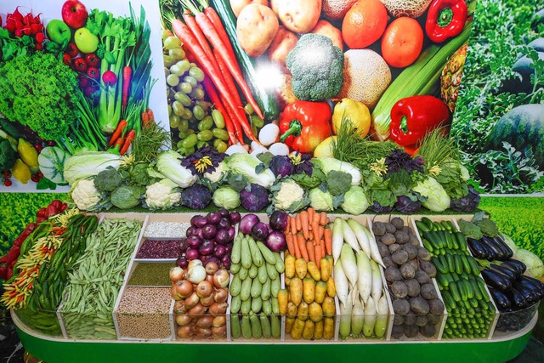
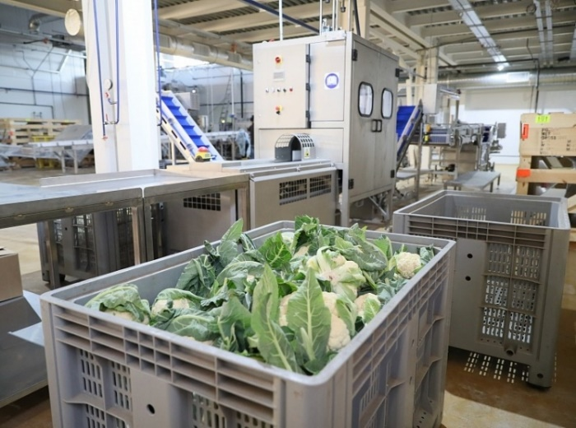
Investment and Export Potential of Bulungur District
2024

Slide 2
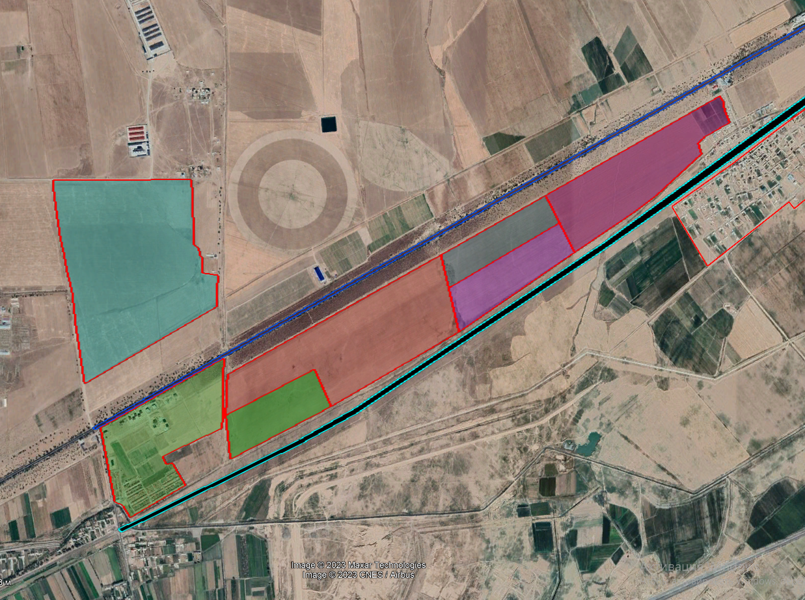
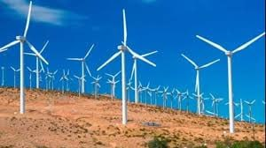
The map of vacant land areas in the "Ghubdin" massif in Bulungur district.
Lalmikor NAC Population: 2,164 people
Jizzakh Region
500 MW wind power station (China)
Kattaqishloq NAC Population: 4,491 people
Main gas pipeline
Proposed land area: 89 hectares
M-39 highway
Ghubdin NAC Population: 3,335 people
Modern greenhouse (Kazakhstan)
Proposed land area 70 hectares
Internet network
Light vehicle manufacturing plant (China)
Railway
Production of medical biopreparations (China)
City of Samarkand
New Uzbekistan residential area (61 houses, 1200 apartments, average population of 8,000)
Total land area: 159 hectares
Olmazor NAC
Population: 5,715 people

Slide 3
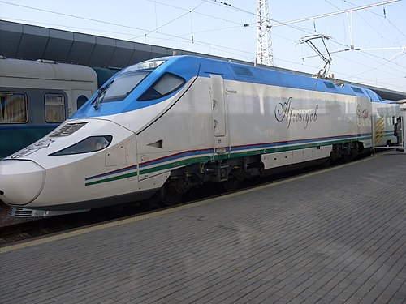
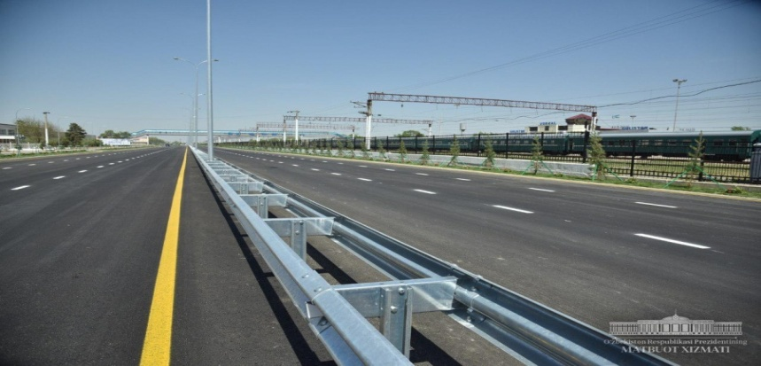
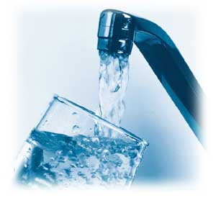
General Information
Established year: 1926
Total area: 76,000 hectares
Location: Southern-eastern part of the region
Population: 200,600 people
Transport infrastructure
Airways - Distance to Samarkand International Airport: 32 km
Railways - Length of railways passing through the district center: 37 km
Roads - Distance to M-39 international highway: 24 km
Territorial infrastructure capabilities
Electric power capacity: 32.0 million kilowatts per hour
Natural gas:
80 million cubic meters
High pressure: 45.5 km
Medium pressure: 74.7 km
Low pressure: 353.6 km
Potable water:
263.4 million cubic meters
Communication:
900 km of optical fiber communication lines

Slide 4
Resources
Labor resources
Skilled labor force: 105,400 people
Economically active population: 82,400 people; including: - women 40,900 people; - men 41,500 people.
Agricultural land: 53,704 hectares
Land resources
Irrigable land: 15,637 hectares
Dry land area– 12,469 hectares
Pasture land: 17,140 hectares
Barren land: 96.0 hectares
Sand and gravel: 5.0 million cubic meters
Mineral resources
Brick raw materials - 1.4 billion. m. cube
Fruits and vegetables - 565,000 tons
Meat - 21,000 tons
Milk - 114,000 tons
Water resources
194.0 mln. cubic liter

Slide 5
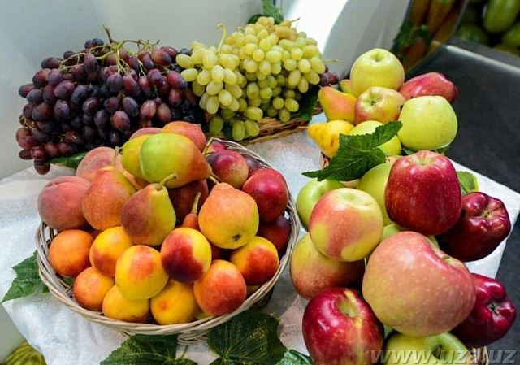
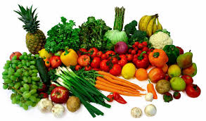
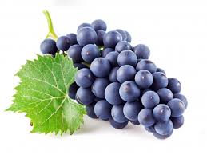
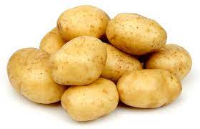
Production of fruits and vegetables
Fruits: 40,000 tons
Vegetables: 450,000 tons
Grapes: 75,000 tons
Potatoes: 280,000 tons

Slide 6
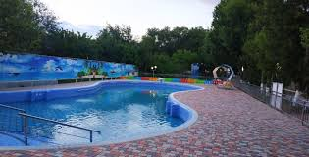
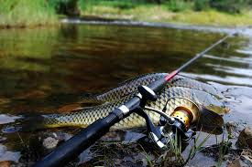
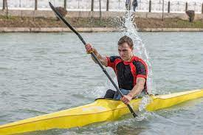
Available Opportunities in the Direction of Tourism in Bulungur District
Providing tourism services along the international highway:
(Motel, general catering, technical services for vehicles)
(With a traffic flow of 60-65 thousand cars per day)
Organizing recreational facilities along the Zarafshan River in the Khojamazgil NAC: (swimming pool, fishing, recreational areas in the nature)
Developing tourism services at the Ghubdin water reservoir
(as per the Decree No. 3405 of November 27, 2017, capacity of 100 million m3)
(boating, jet skiing, air travel)

Slide 7
Advantages and Preferences for Foreign Investors
"Measures to Stimulate Attraction of Direct Foreign Investments" - Decree (PF-3594, April 11, 2005)
Tax for development and improvement of social infrastructure
Land tax
Payment to the Republic Road Fund
Property tax on legal entities
Compulsory payments to the fund for the development of the material and technical base of educational and medical institutions outside the budget
Income tax
Incentives based on the volume of invested capital:
1. Up to 300,000 dollars - for a period of 3 years;
2.From 3.0 million dollars to 5.0 million dollars - for a period of 5 years;
3.From 5.0 million dollars to 10.0 million dollars - for a period of 7 years;
4.If the investment is 10.0 million dollars or more, for a period of 10 years.
Unified tax payment

Slide 8
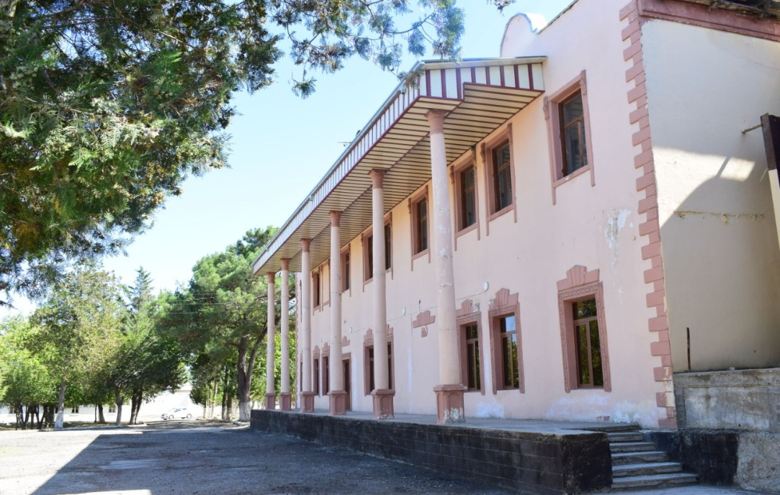
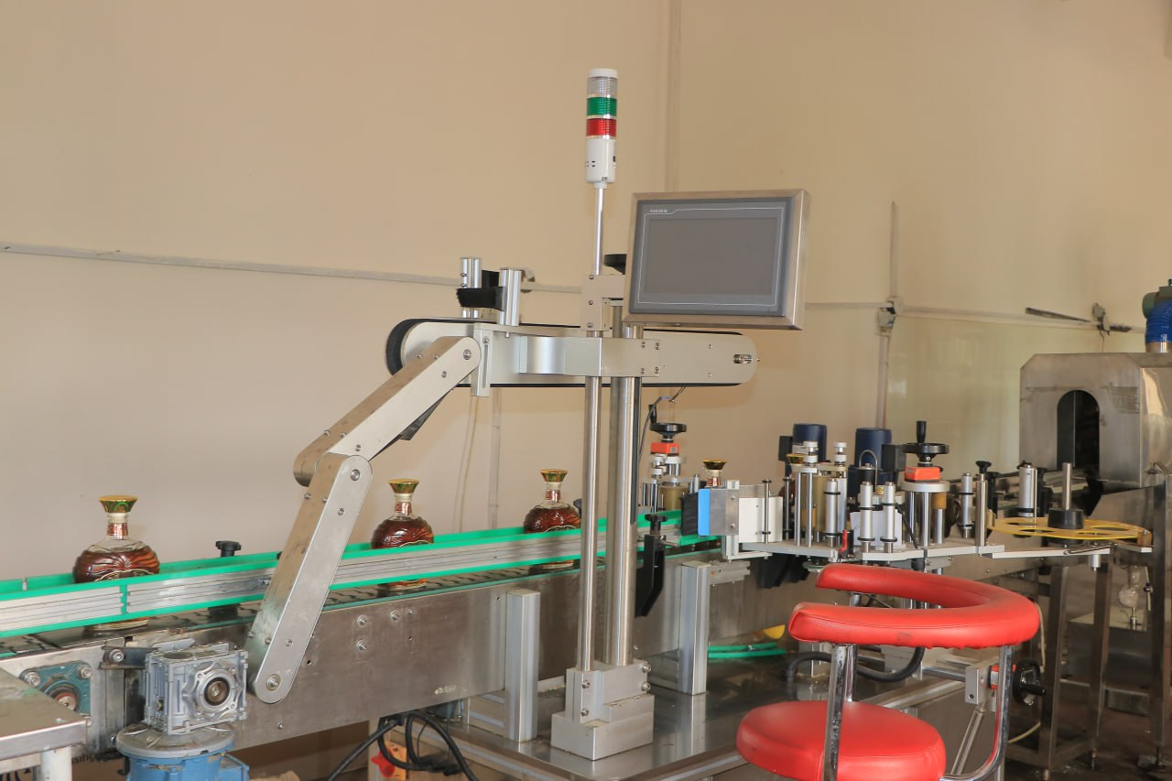
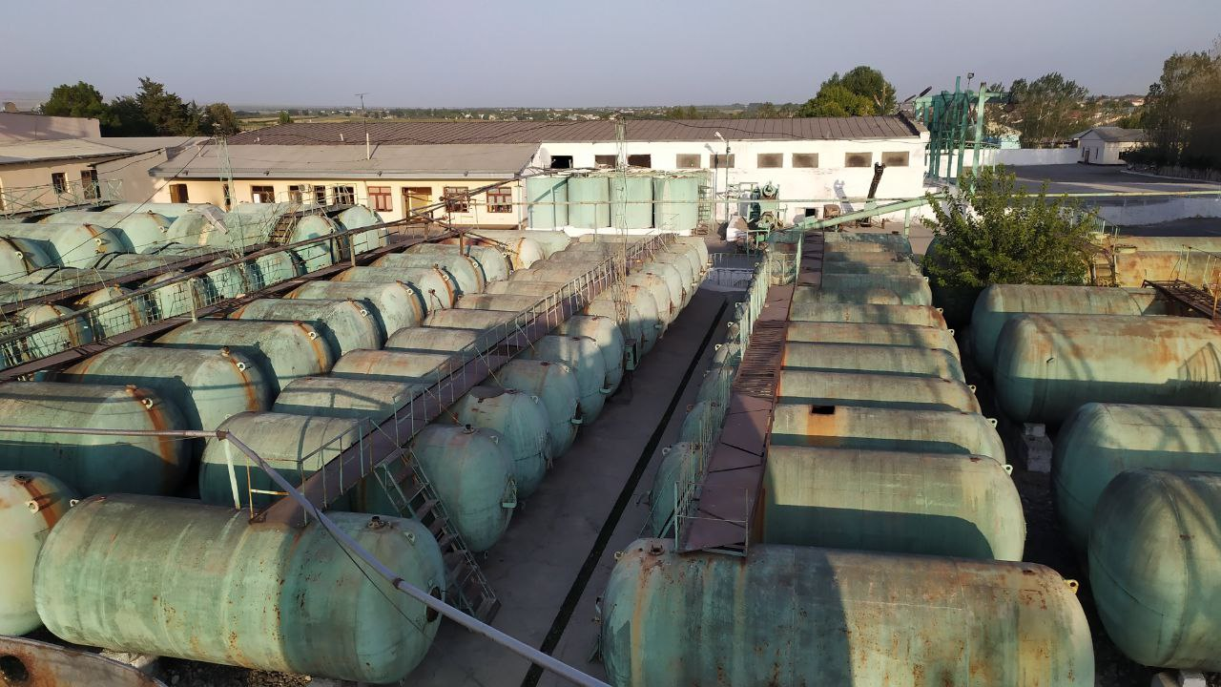
Current Status of ”Bulungur-1" LLC factory
Address: Yangiobod NAC
Established: 1973
Total land area: 3.86 hectares
Construction area: 510 square meters
Vineyard area: 100.0 hectares
Main activity: Processing grapes and producing alcoholic beverages
Number of metal barrels: 128 (volume of 21 tons each)
Production capacity: 30,000 tons of grapes, 60,000 dollars of wine, 10,000 dollars of brandy, 12,000 dollars of brandy spirits
Engineering and communication networks: Available (electricity, gas, water, road)
SUGGESTIONS
Collaboration
Sale
Rent
+99893 348-55-22

Slide 9
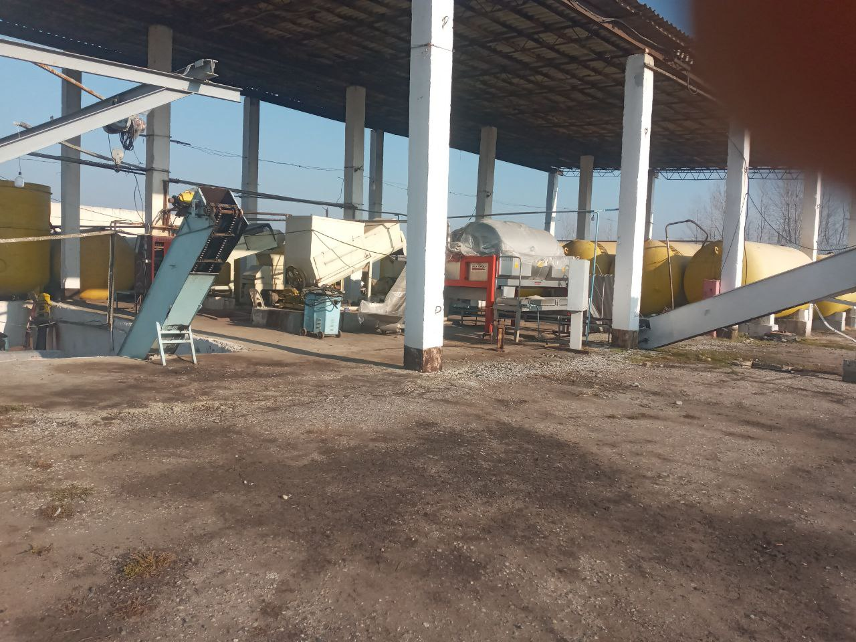
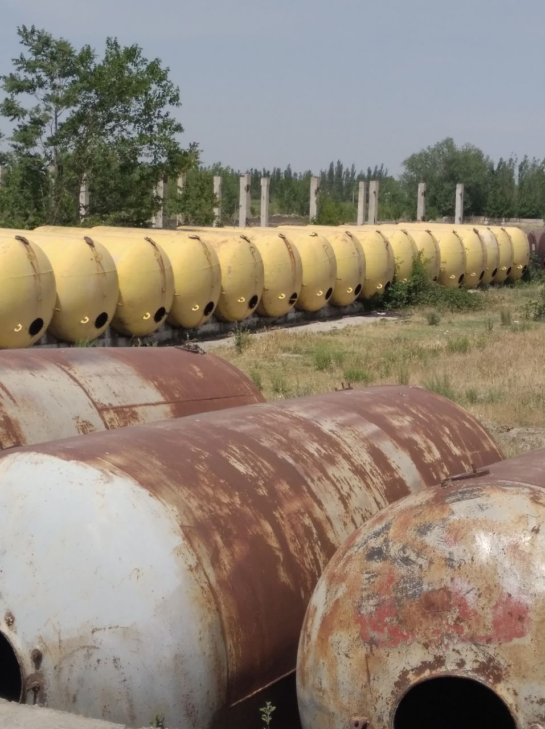
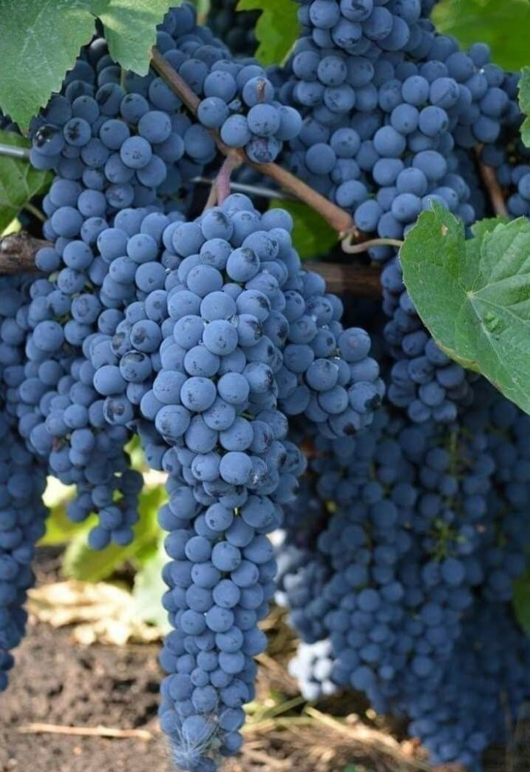
Current Situation of “Mehnat Agrofirma" LLC
Address: Zarafshon NAC
Established : 1989
Total land area: 4.21 hectares
Construction area: 1054 square meters
Vineyard area: 210.0 hectares
Main activity: Processing and producing wine
Production capacity: 30,000 tons of grape processing
Number of metal barrels: 39 (30 with a volume of 25 tons, 9 with a volume of 16 tons, total volume 894 tons)
Engineering and communication networks: Available (electricity, gas, water, road)
SUGGESTIONS :
Collaboration
Sale
Rent
+99897 919-07-79

Slide 10
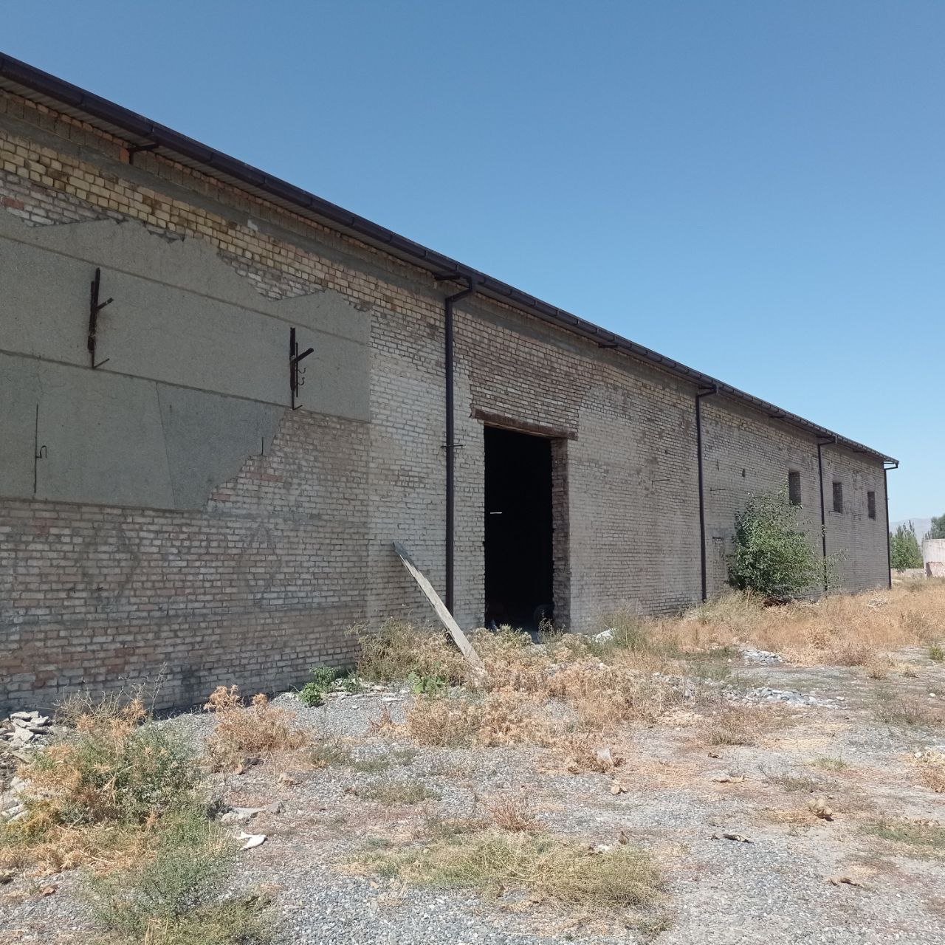
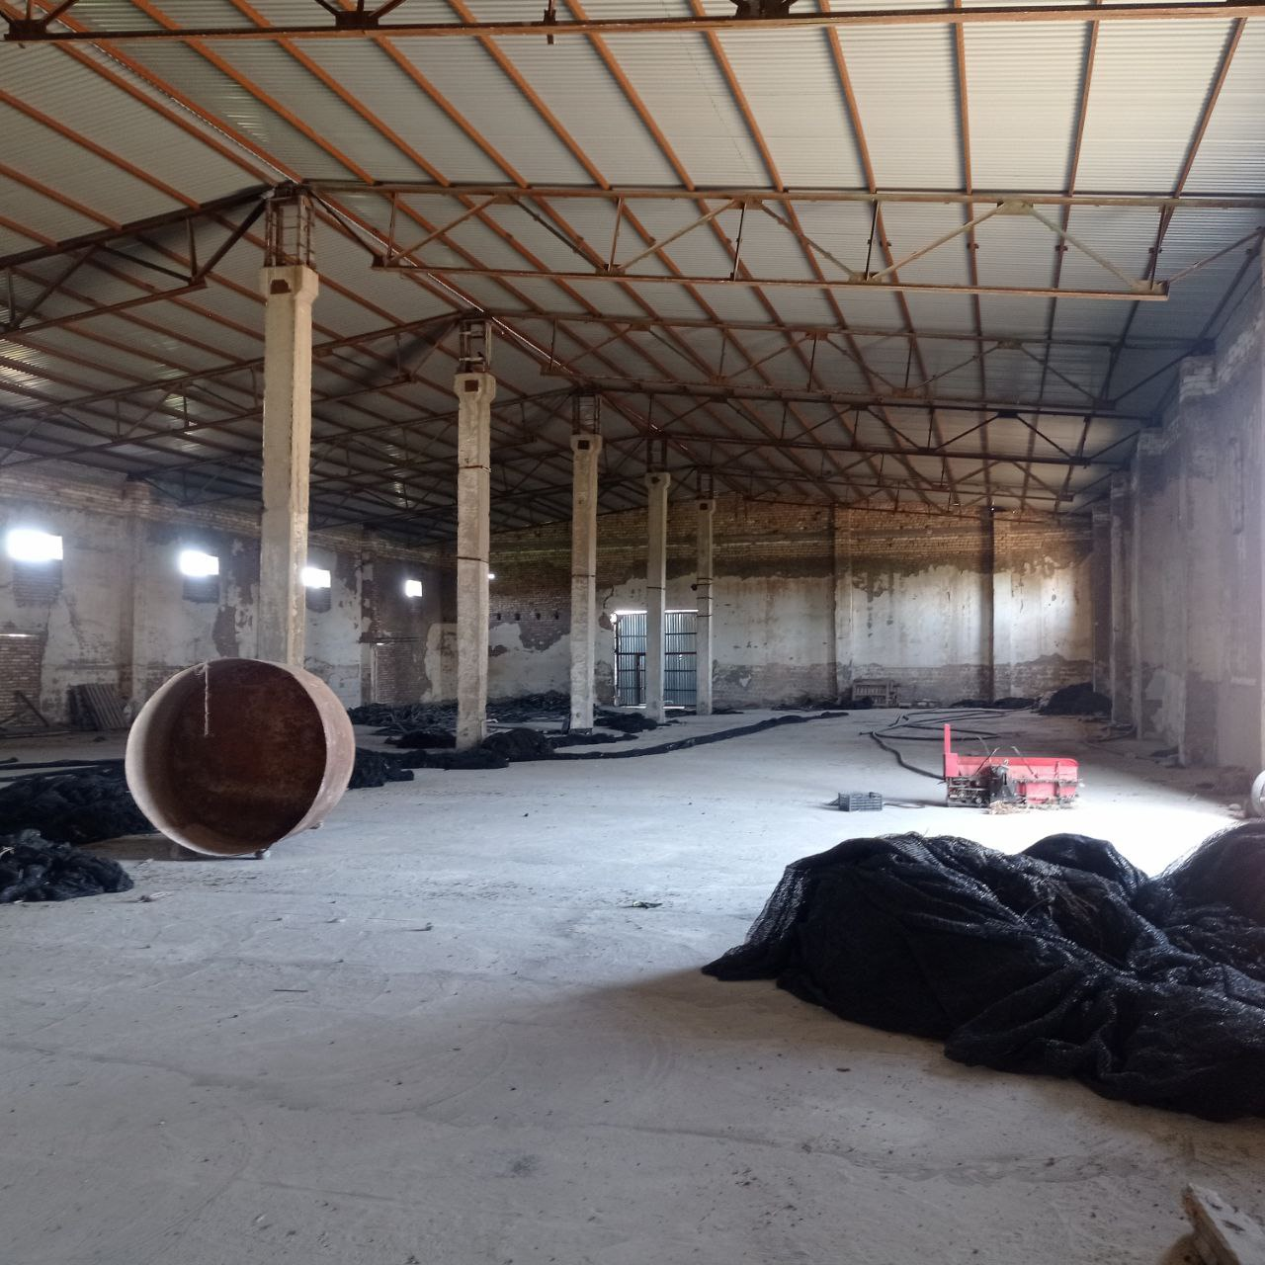
Information About the Vacant Former Winery
Address - Erganakli NAC
Total land area - 8.0 hectares
Construction area - 1100 square meters
Distance to the international highway - 6 km
Distance to the railway - 14 km
Engineering and utility networks - Available (electricity, water, road)
SUGGESTIONS
Collaboration
Sale
Rent
+99890 965-26-49

Slide 11
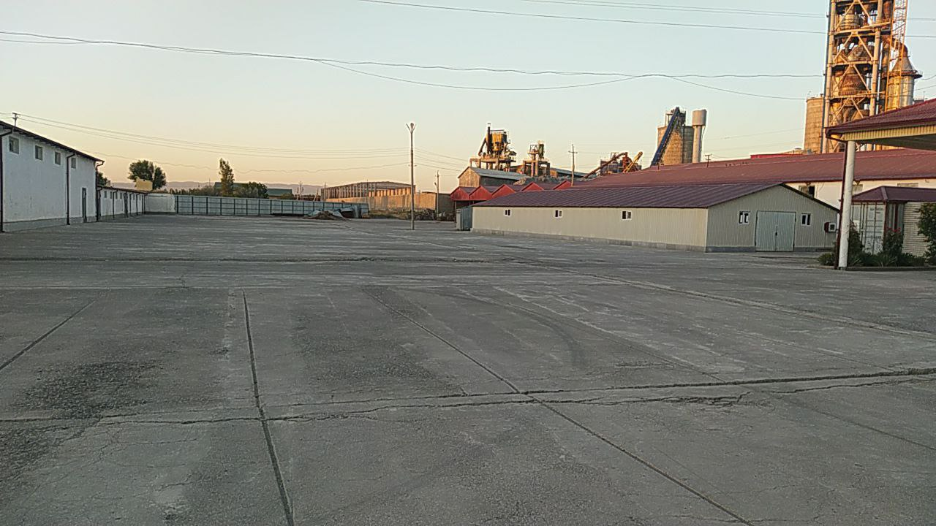
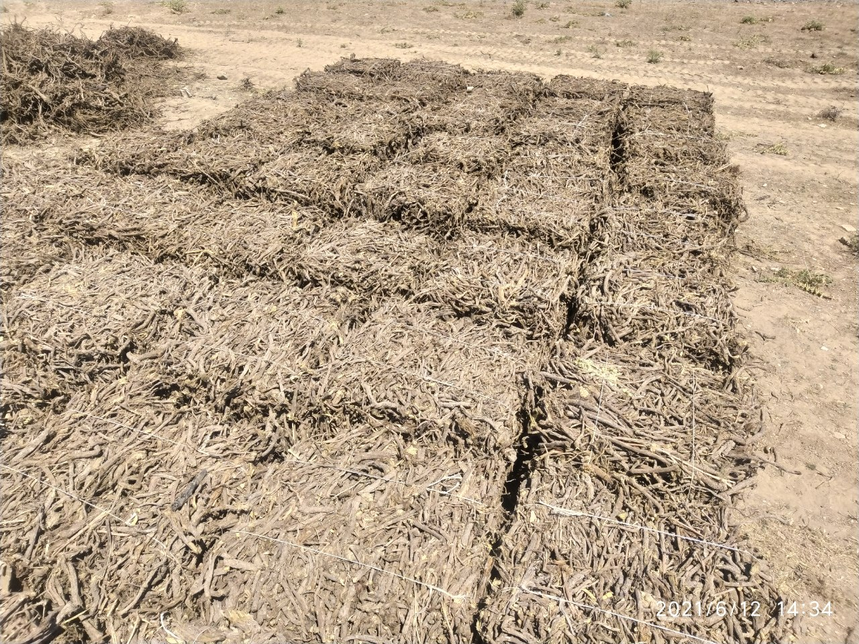
Current Status of ”Raise production business“ LLC
Address – Jomboy District
Established year– 2015
Total land area – 1,86 hectares
Construction area - 5800 square meters
Main activity – Licorice root processing and licorice extract production
The available equipments : imported from China
Production capacity - processes 4.5 thousand tons of licorice root and produces 360 tons of licorice root extract
Engineering and communication networks - Existing (electricity, gas, water, road)
SUGGESTIONS
Collaboration
Sale
Rent
+998937215569

Slide 12
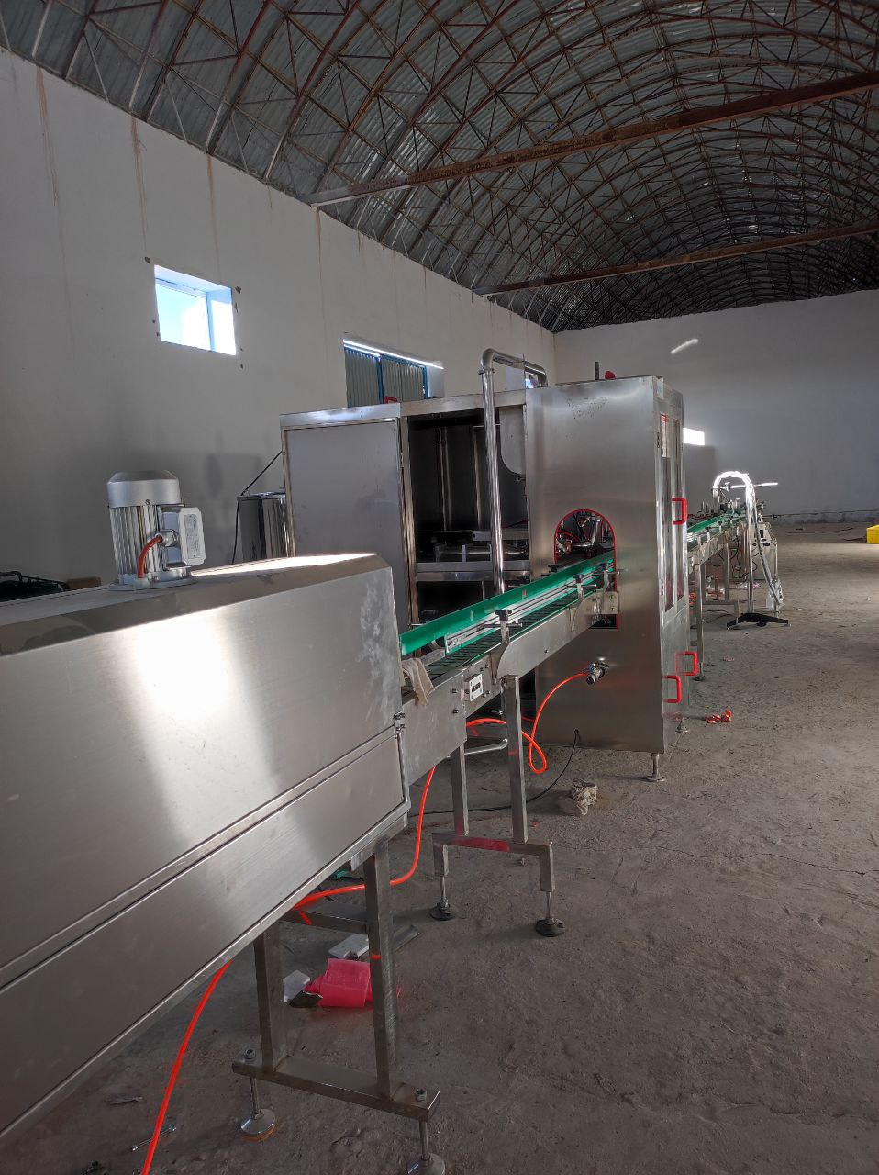
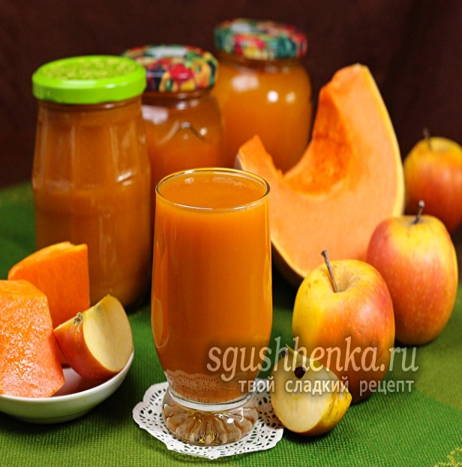
The project of ”Saxix bek-baraka" LLC ”Tomato processing and tomato paste production"
Address – Ghobdin NAC
Established – September 27, 2018
Total Land Area – 0.7 hectares
Расм | асм
Расм | Расм
Construction Area – 3000 square meters
Agricultural Land Area – 80 hectares
Main Activities – Processing tomatoes, producing tomato paste, and processing apples
Available Equipments – Imported from China
Production Capacity – Capable of processing 6,000 tons of tomato and apple products
Engineering and Communication Networks – Available (electricity, gas, water, road)
SUGGESTIONS
Collaboration
Rent
+99888 397 11 18

Slide 13
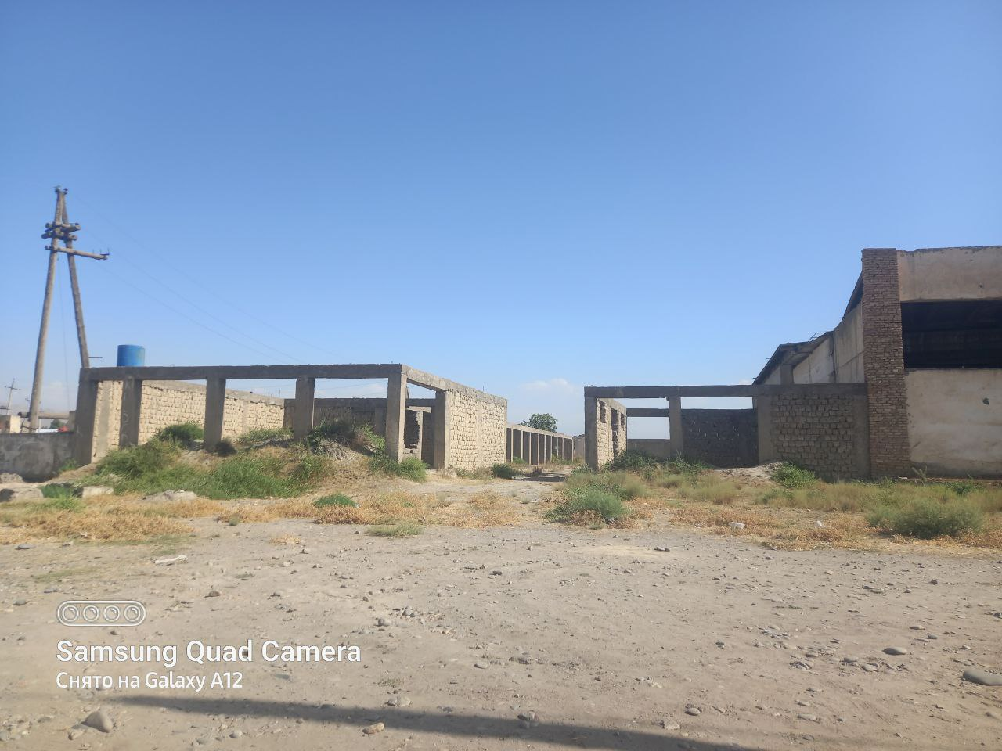
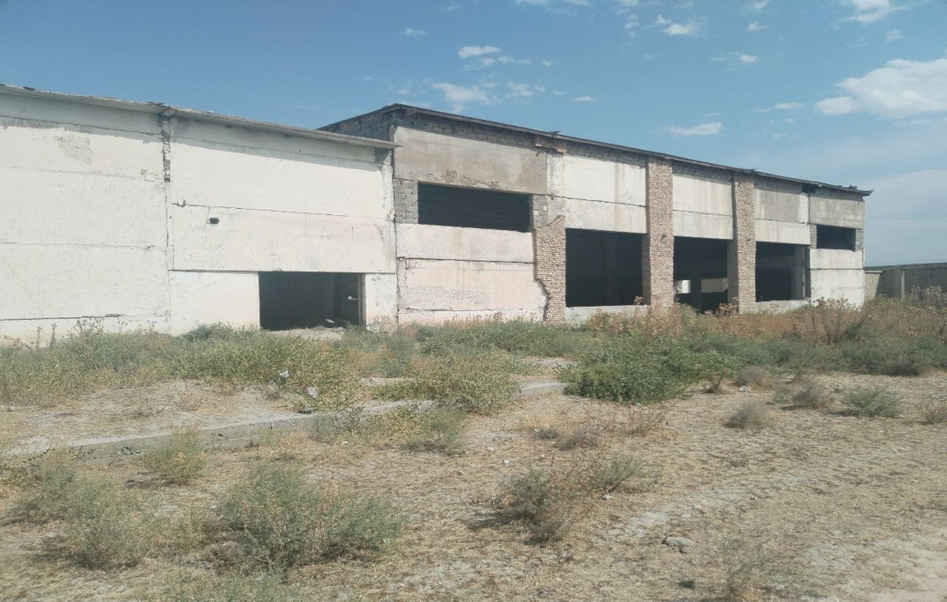
Information About ”Me‘mor" LLC
Address – Kildon NAC
Total Land Area – 1.45 hectares
Construction Area – 1436 square meters
Distance to the international highway – 18 km
Distance to the railway – 18 km
Engineering and Communication Networks – Available (electricity, water, road)
SUGGESTIONS
Collaboration
Sale
Rent
+99890 212-77-77

Slide 14
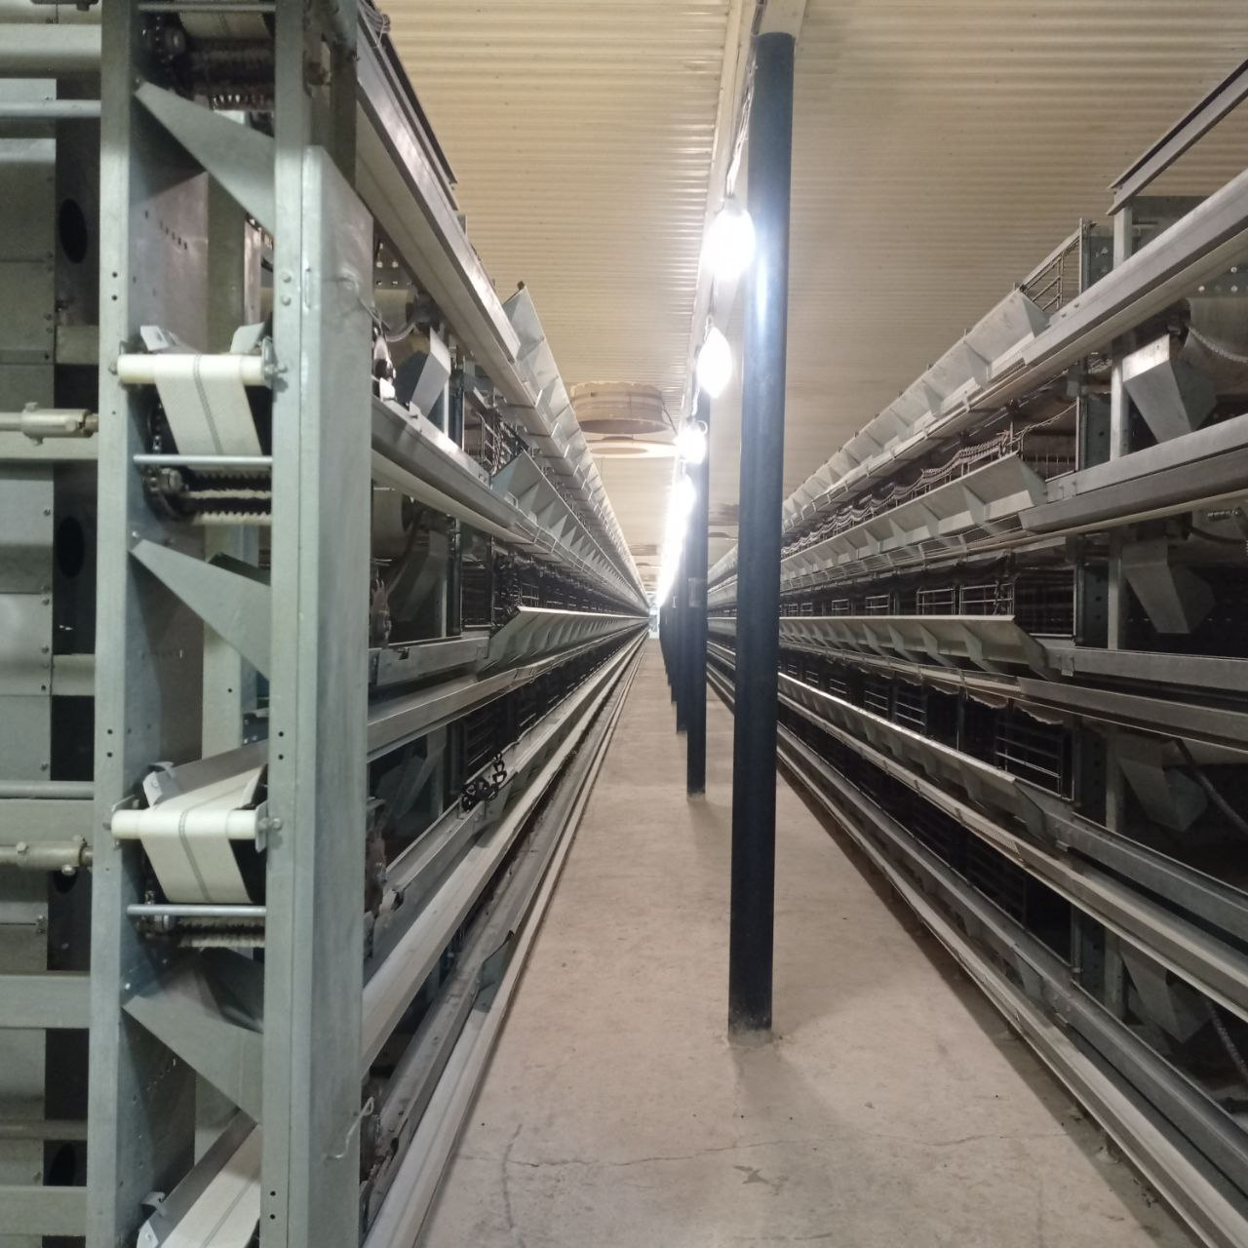
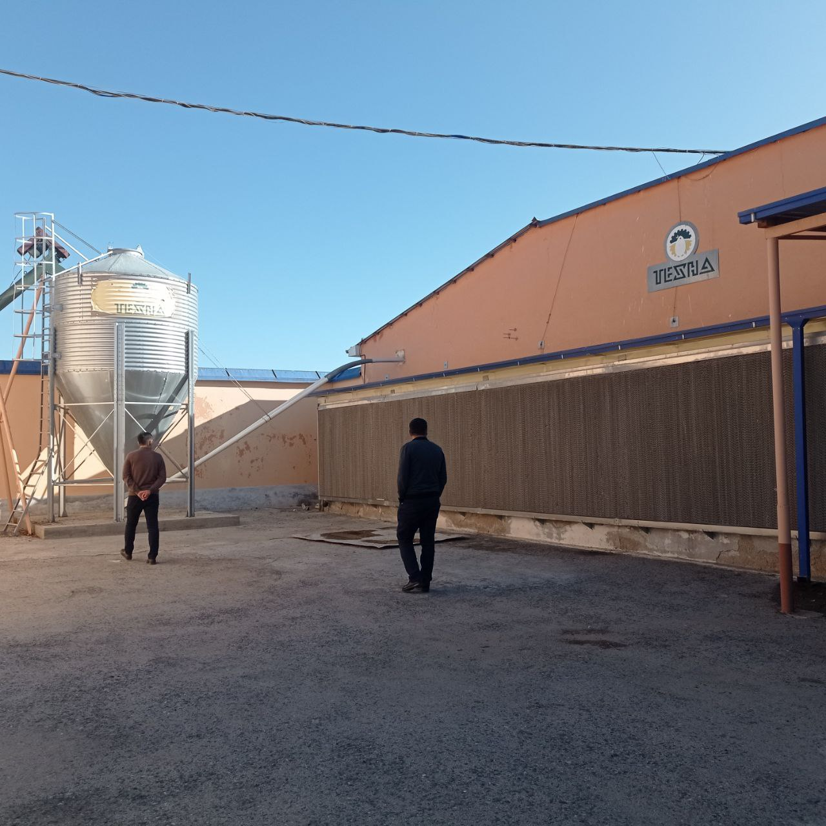
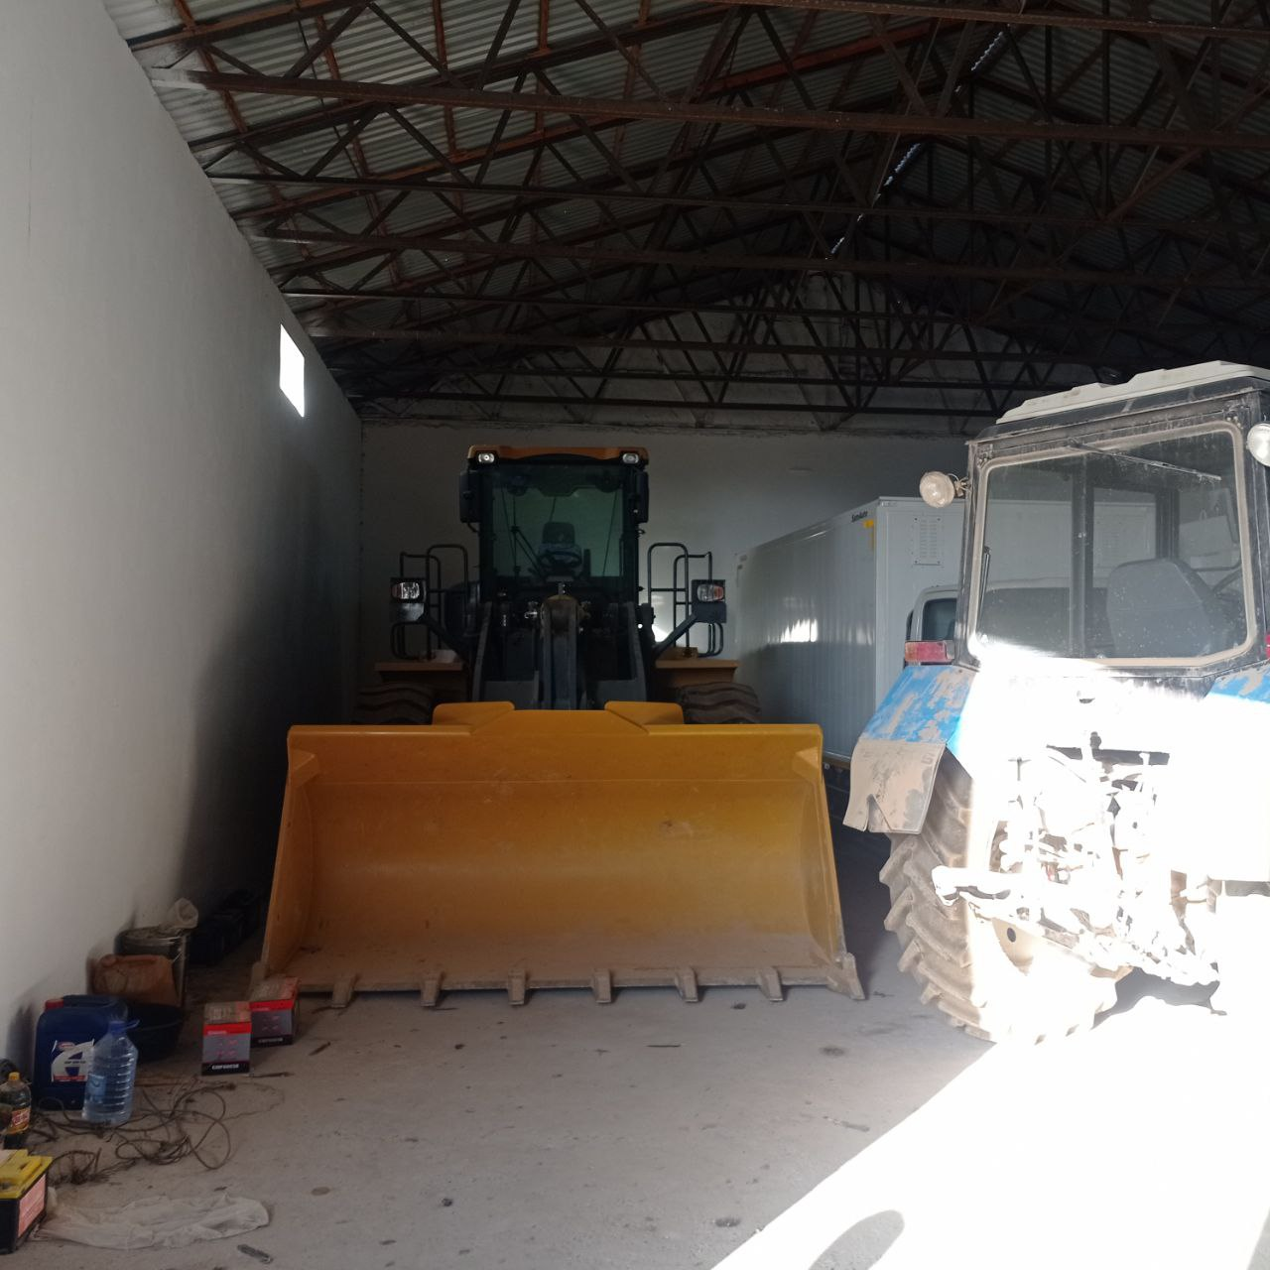
Information About Poultry Buildings Belonging to ”Grand Fayz Nur" farm
Address – Yangiariq NAC
Activity – Poultry farming (eggs)
Capacity – 50,000 birds
Annual Capacity – 15 million eggs
Equipment Manufacturing Country – Ukraine
Total Land Area – 1.5 hectares
Construction Area – 2100 square meters
Engineering and Communication Networks – Available (electricity, water, road)
SUGGESTIONS
Collaboration
Rent
+99899 599-78-77

Slide 15
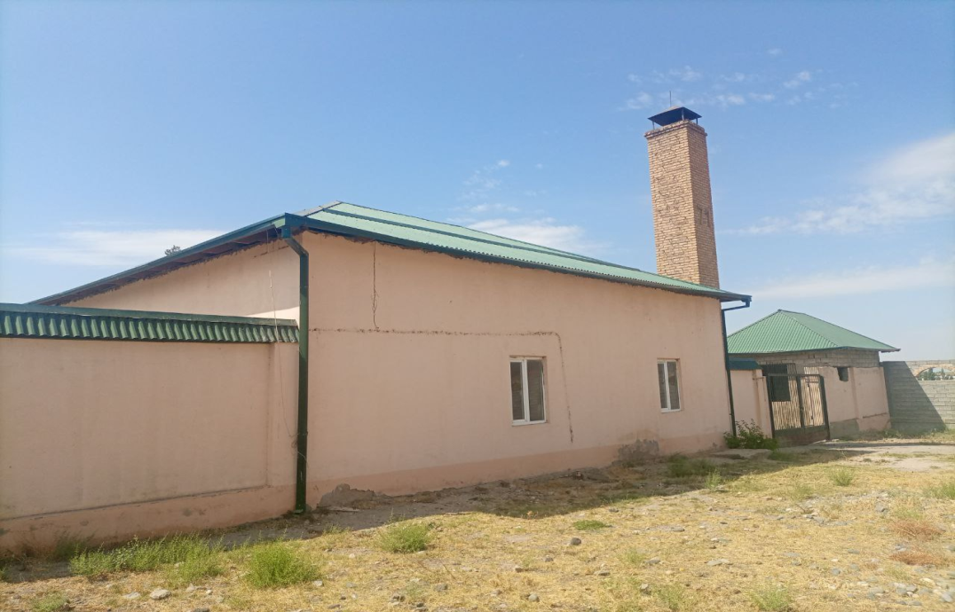
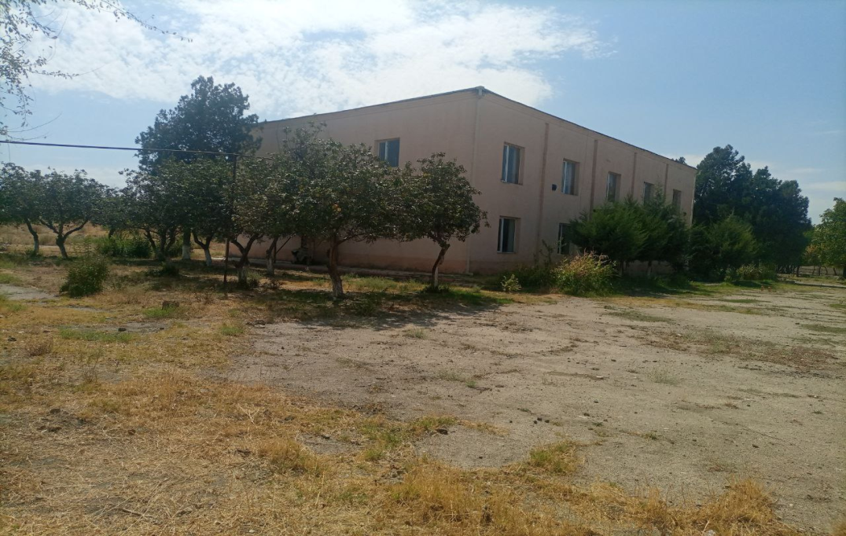
Information About "Artek International" LLC JV
Address - Yangiobod NAC
Total land area - 1.5 hectares
Construction area - 3040 square meters
Distance to highway - 0.5 km
Distance to the railway - 1 km
Engineering and utility networks - Available (electricity, water, road)
SUGGESTIONS
Collaboration
Sale
Rent
+99897 615-26-08

Slide 16
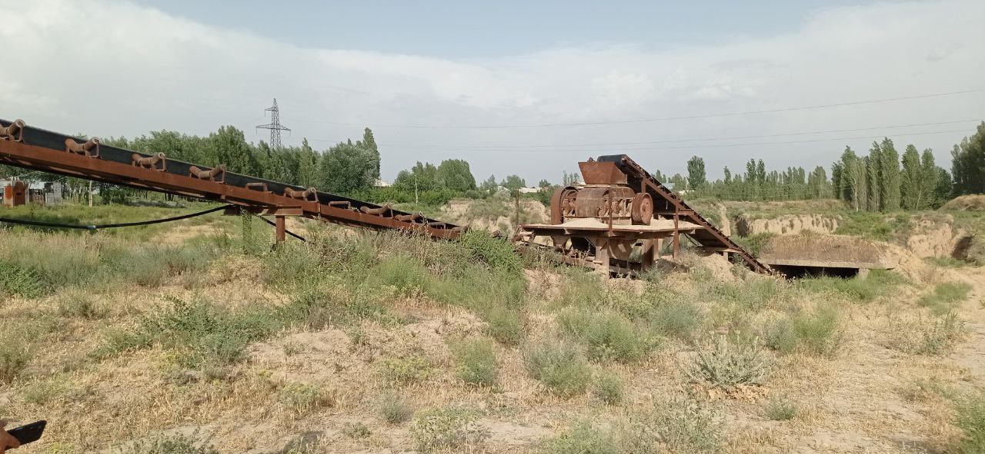
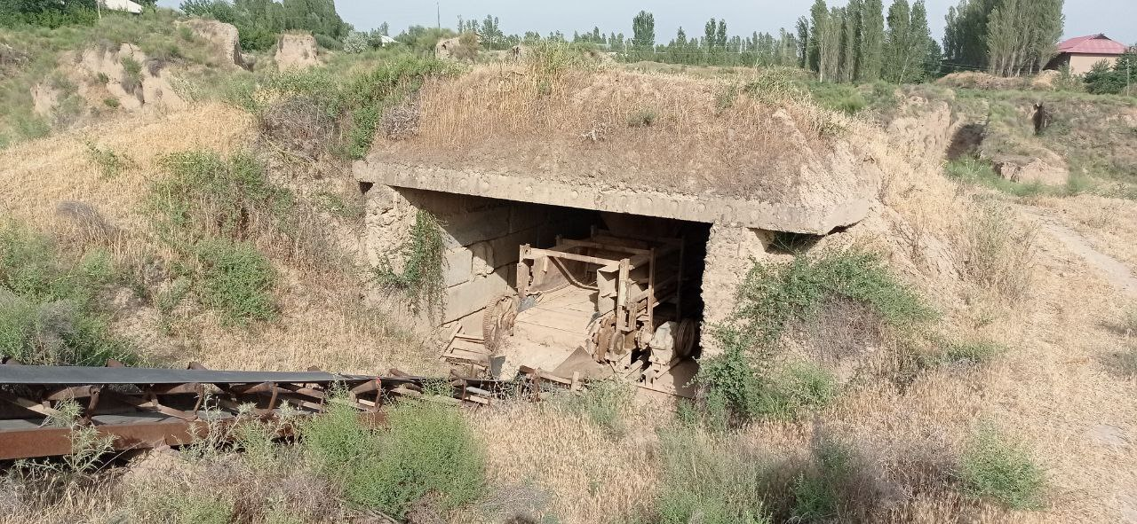
Information About ”Bulungur ocha gisht" JSC
Address - Ulugbek NAC
Total land area - 3 hectares
Construction area - 240 square meters
Raw material area - 2 hectares
Proposed project - Production of fired bricks
Distance to the highway - 8 km
Distance to the railway - 8 km
Engineering and utility networks - Available (electricity, water, road)
SUGGESTIONS
Collaboration
Rent
+99899 626-99-66

Slide 17
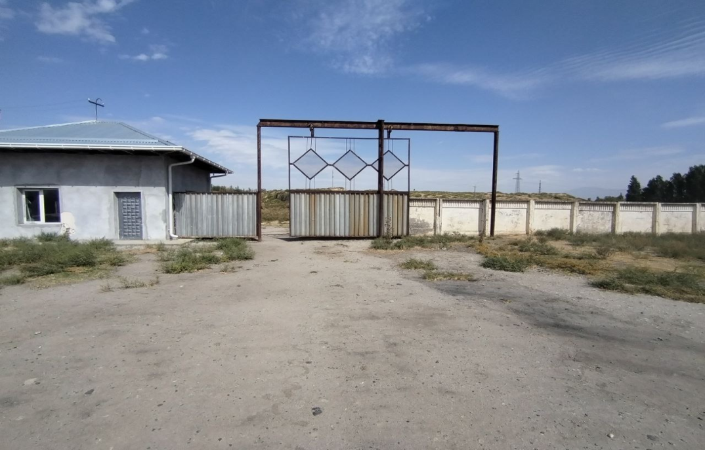
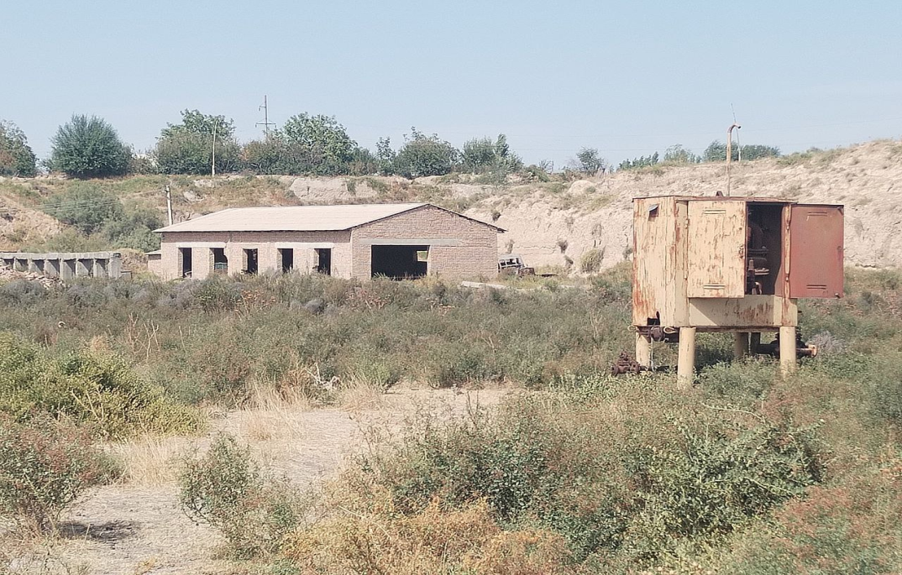
Information About ”Marokand Invest Construction Service" LLC
Address - Gulzor NAC
Total land area - 2.46 hectares
Construction area - 578 square meters
Distance to the highway - 10 km
Distance to the railway - 10 km
Engineering and utility networks - Available (electricity, water, road)
SUGGESTIONS
Collaboration
Sale
Rent
+99893 727-34-32

Slide 18
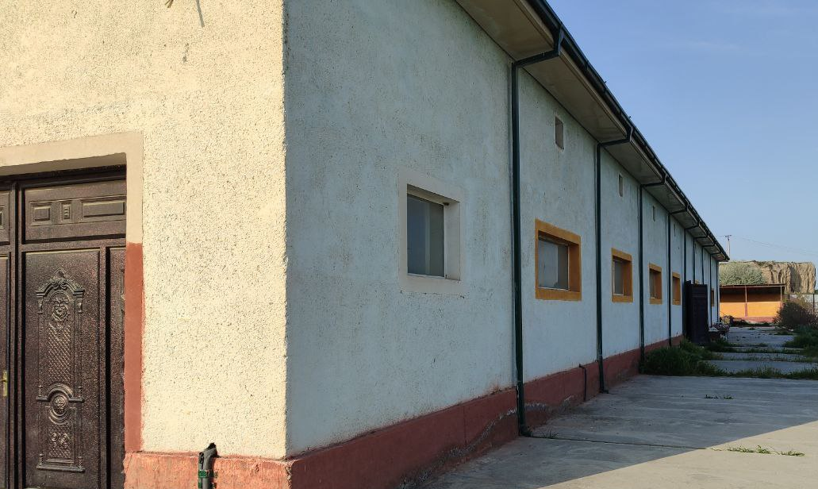
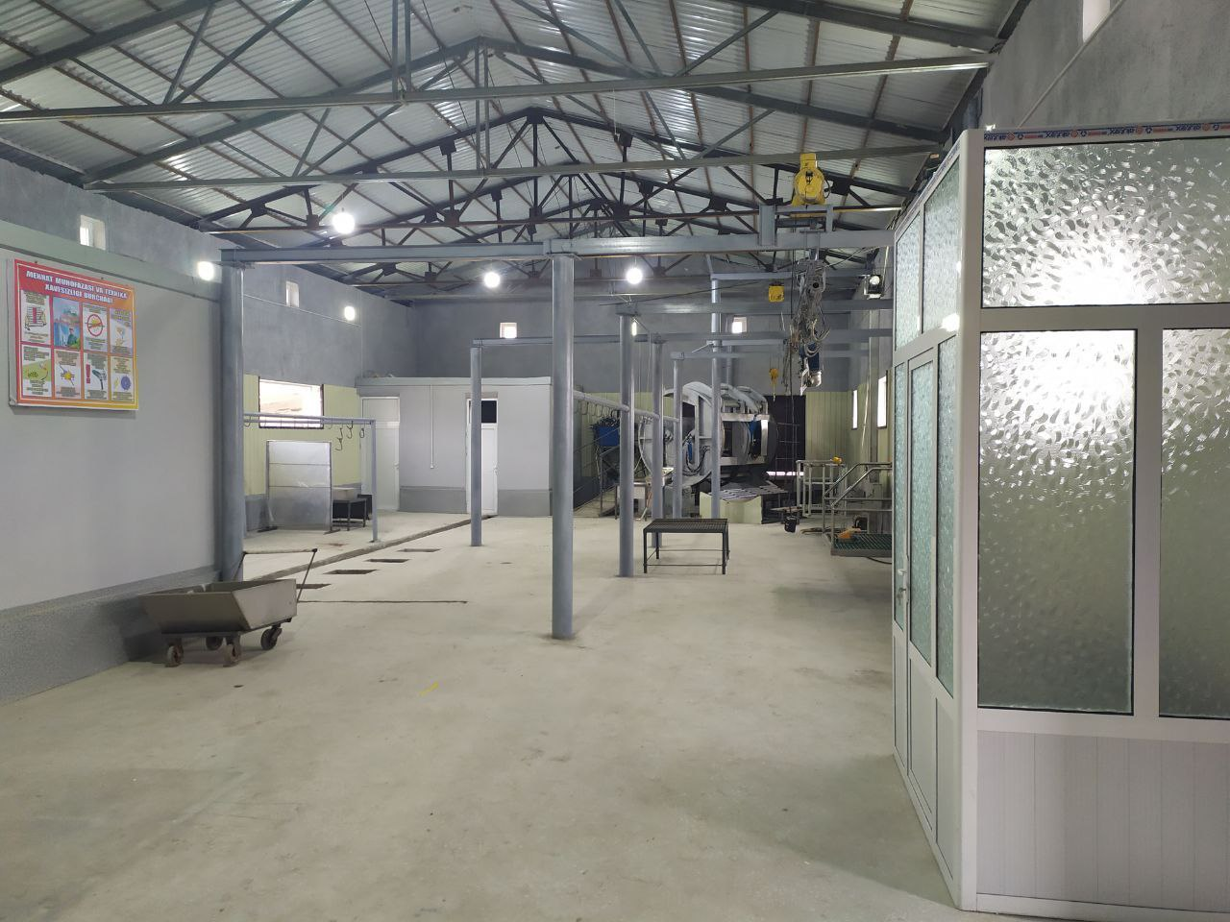
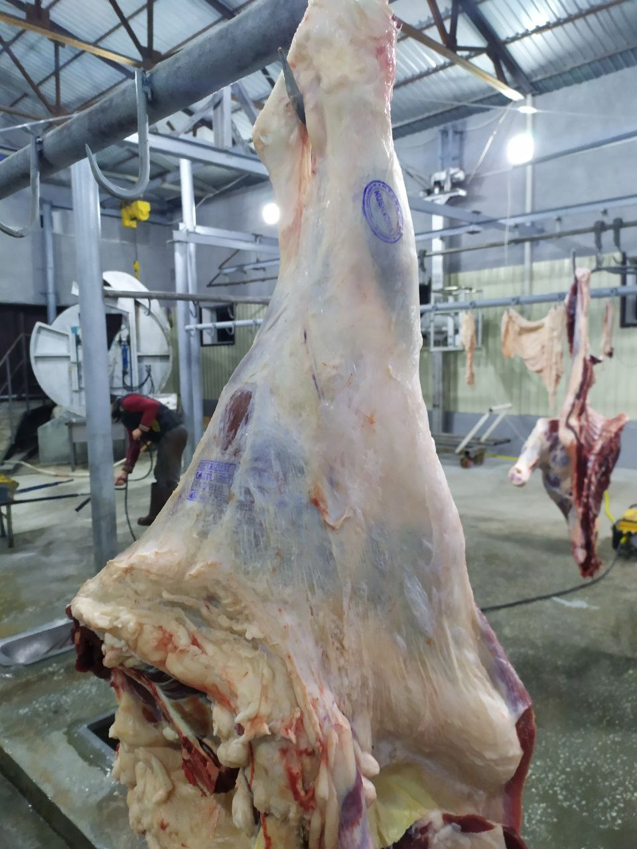
Information About “Intershell LLC” related poultry buildings
Address - Yangiarik NAC
Establishment year - 2018
Activity - Poultry farm (slaughterhouse and leather collection point)
Annual capacity - 1,200 tons
Equipment manufacturing country - China
Total land area - 1.0 hectares
Construction area - 986 square meters
Engineering and utility networks - Available (electricity, gas, water, road)
SUGGESTIONS
Collaboration
+998915257085

Slide 19
Proposal to establish hydroelectric power station in Bulungur district
Existing potential of the area
Benefits available
In the southern part of Bulungur district, the Zarafshan River enters through the Republic of Tajikistan. The Zarafshan River has cut through 15 kilometers of the district. Apart from this, there is a Tuji Tortar canal along the river, with a depth of 20 meters and a width of 2.5-4.5 meters. The water flow of the canal is 45 cubic meters per second. This canal provides convenient conditions and opportunities for installing micro hydroelectric power plants in the gorge.
Residents and industrial enterprises located in this area benefit from the canal.
According to Presidential Decree No. PF-220 from September 9, 2022, "On additional measures to develop renewable energy sources and promote technologies for energy-efficient and small-scale decentralized power generation," it is guaranteed to purchase electric energy for a period of not less than 15 years. In addition to this, it is possible to conclude a direct sales contract for the sale of the produced electric energy to individuals and legal entities through the establishment of local networks without connecting it to the unified power system.
Based on Presidential Decree No. PP-57 dated February 16, 2023, "On accelerating measures to develop renewable energy sources and energy-efficient technologies in 2023," starting from April 1, 2023, legal entities that install renewable energy facilities with a total capacity of up to 100 kW for physical persons and general power supply, are eligible to receive tax benefits for the property used for these facilities, as well as income from the sale of electric energy to legal entities. These tax benefits are provided for a period of three years from the date of commissioning, and if a storage system for storing electric energy with a capacity of not less than 25 percent is installed, tax payments are exempted for one year.

Slide 20
Possibilities of growing and processing potatoes
Existing potential of the area
Potatoes are considered a staple food and are widely grown in Uzbekistan, especially with more than 15 varieties available. The vegetation period ranges from 70 to 130 days. Depending on the duration of the growing period, potatoes are divided into early varieties with a growing period of 70-80 days, mid-season varieties with a growing period of 90-100 days, and late varieties with a growing period of 120-130 days.
The total irrigated arable land in Bulungur District is 15,637 hectares, with an average annual
Spring potatoes are planted on 5.2 thousand hectares and autumn potatoes on 3.5 thousand hectares. Arizona, Evolution, Picasso, Sante, Esmi, Savyolla and other potato varieties are grown in the district. The positive aspect of these varieties is that they are suitable for the soil-climatic conditions of the district and have high productivity.
Average yield is 260-280 thousand tons per year from 300-600 quintals. This area accounts for 55-60 percent of the total potato harvest.
- "Arizona" variety is suitable for the climate of the region, ripens on average and yields up to 600 centners.
- Santo, Evolution varieties - suitable for district climate, early.
- Picasso, Esmi varieties - suitable for the climate of the district, moderately ripe
Yields up to 600 centners.
10.6 thousand tons of the total harvest is used for domestic needs, 5.9 percent. The remaining 94.1 percent of the products were sold to other regions.
The above figures confirm that Bulungur district is the most favorable region for potato processing.

Slide 21
Cultivation and processing of grapes in Bulungur district
Existing potential of the area
Available benefits
The geographical location of Bulungur district, climatic conditions, active temperature of the sun, fertile irrigated lands and unique mountainous regions created the ground for the development of viticulture on an industrial scale.
The total cultivated area in Bulungur district is 15,600 hectares, of which 5,246 hectares are for grapes, so 56% of it is the area of ​​khoraki and kishmishbop grapes. The area of ​​industrial grapes is 2308 hectares, or 44% of the total area of ​​vineyards.
Black currant, Rizamat ota, Mediniy, industrial Caberni, Saperavi, Boyan syrup varieties are mainly grown in the district. The positive side of these industrial varieties is that they give an average yield of 300 centners per hectare and create ample opportunities for the production of wine, brandy, and brandy alcohol.
In accordance with the President of Uzbekistan's Decree No. 144 dated March 1, 2022, on the "New Irrigation Systems in Agriculture" concert, a direct replenishment system of 8.0 million soums per hectare for vineyards is provided. Additionally, subsidies for drilling irrigation wells will be approved at 600 thousand soums per meter, but not exceeding 120 million soums in total, in collaboration with the relevant entrepreneurs.
As a result of the programs adopted for the development of industrial viticulture during the years 2017-2022, 874 hectares of industrial vineyards were established. Additionally, there are 2,200 hectares of rain-fed land available in the district for establishing industrial grape plantations.
If an average of 65-75 thousand tons of grapes are grown annually in the district, 10 percent of this is processed by the existing enterprises in the district. A total of 10 thousand tons or 14 percent of the harvest is directed towards processing and domestic consumption. The remaining 86 percent of the product is sent to neighboring regions and exported.
Based on the above information, the establishment of a grape processing plant in the "Urgut" free economic zone is being evaluated as a promising project. If a grape processing plant is established in the future, the significant historical experience of the population in grape cultivation will ensure that there will be no issues regarding skilled workers.

Slide 22
Thank you for your attention
ADDRESS:
140200,
Republic of Uzbekistan,
Samarkand province,
Bulungur district,
Independence square 1 house
https://www.bulungur.uz/

